Slide 1
Project AEDES Enhancement
CirroLytix Research Services
October 2021

Slide 2
Agenda
Current state and use-cases
Feedback on prototype
Areas of enhancement
Team composition

Slide 3
Project AEDES Front-end

Slide 4
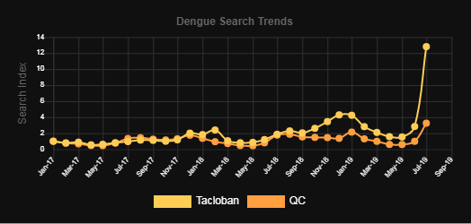
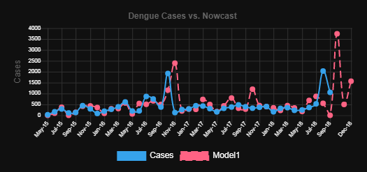
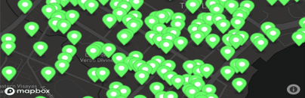
Dengue Panic Alerts
Dengue Case Nowcasting
Dengue Hotspot Detection
Use-case
Visualization API
Chart JS
Mapbox API
Front-end Stack
Web Front-end
Back-end Stack
AJAX / PHP
Google Search Trends
PAGASA Precipitation
PAGASA Temperature
DOH Epi Bureau Cases and Deaths
Sentinel FAPAR
Sentinel NDVI
Sentinel NDWI
Datasets

Slide 5
Prototype Feedback and Challenges
Current data not available
Data gathering and preparation is manual
Dashboard is counter-intuitive, needs elaboration
Policy usage of the information is unclear
Scope of solution is too narrow (dengue), needs relevance

Slide 6
Areas of Enhancement
Risk-based Framework
Improved Insight generation
Data gathering Automation
Interface Improvement
Expansion of use-cases
LGU Engagement

Slide 7
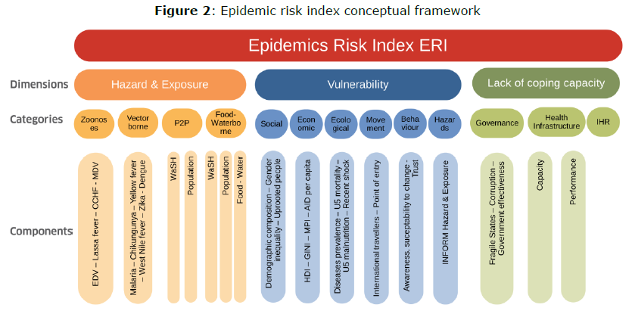
INFORM Risk Framework
INFORM was developed by the EU JRC.
Risk framework provides data-driven policy ideas and actionable strategies.

Slide 8
INFORM AEDES Data (Proposed)
Hazards | Vulnerabilities | Coping Capacity
Dengue Case incidence Flood Occurrence Temperature Precipitation COVID-19 Incidence Access to water Access to sanitation | Population ages 0-20 Poverty Index Population affected by natural disasters Population previously infected by dengue Mortality Land-use types Social listening Primary and secondary schools Philhealth coverage Human mobility | Presence of health centers Presence of hospitals Number of health workers Health expenditure Vaccination coverage

Slide 9
Risk-based Decision Use-cases
Hazards – monitor progress of epidemic, generate alerts
Vulnerabilities – prioritize areas with vulnerable groups, suggest demographic and geographic determinants of risk
Coping Capacity – prioritize areas for emergency aid, recommend infrastructure investment

Slide 10
Sentinel 2
NDWI
FAPAR
QGIS
GPS Lat-Long
Hotspots
Mapbox
Landsat 8
NDVI
Avg Temp
Nowcast
Chart JS
Web Portal
DOST-PAGASA
Avg Precipitation
dengue
Linear Modeling
Google Trends
Jupyter
dengue symptoms
dengue medicine
Alerts
Chart JS
dengue cure
DOH
Dengue case counts
High-level Architecture v 1.0 – 2.0
Dengue deaths

Slide 11
Sentinel 2
NDWI
GPS Lat-Long
Hotspots
Mapbox
FAPAR
Landsat 8
NDVI
Avg Temp
INFORM
Risk Mapping
Mapbox
Web Portal
Avg Precipitation
dengue
Google Trends
API
dengue symptoms
Linear Modeling
dengue medicine
Nowcast
Chart JS
dengue cure
DOH
Dengue case counts
High-level Architecture v 3.0
Dengue deaths

Slide 12
Expanded Satellite Indicators
Surface Conditions | Air Quality | Climate and Hazards
FAPAR NDWI NDVI NDBI | PM2.5 NO2 SO2 CO2 | Temperature Rainfall Earthquake Zone Flooding Zone

Slide 13
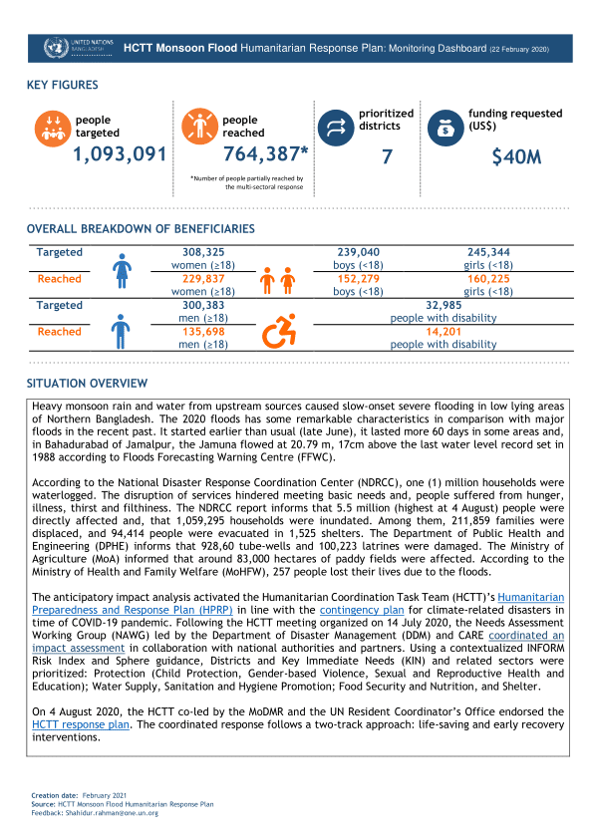
Interface Improvement
Current Dashboard
INFORM Risk Mapping
Sit-rep and Alerts
Epidemic Indicators

Slide 14
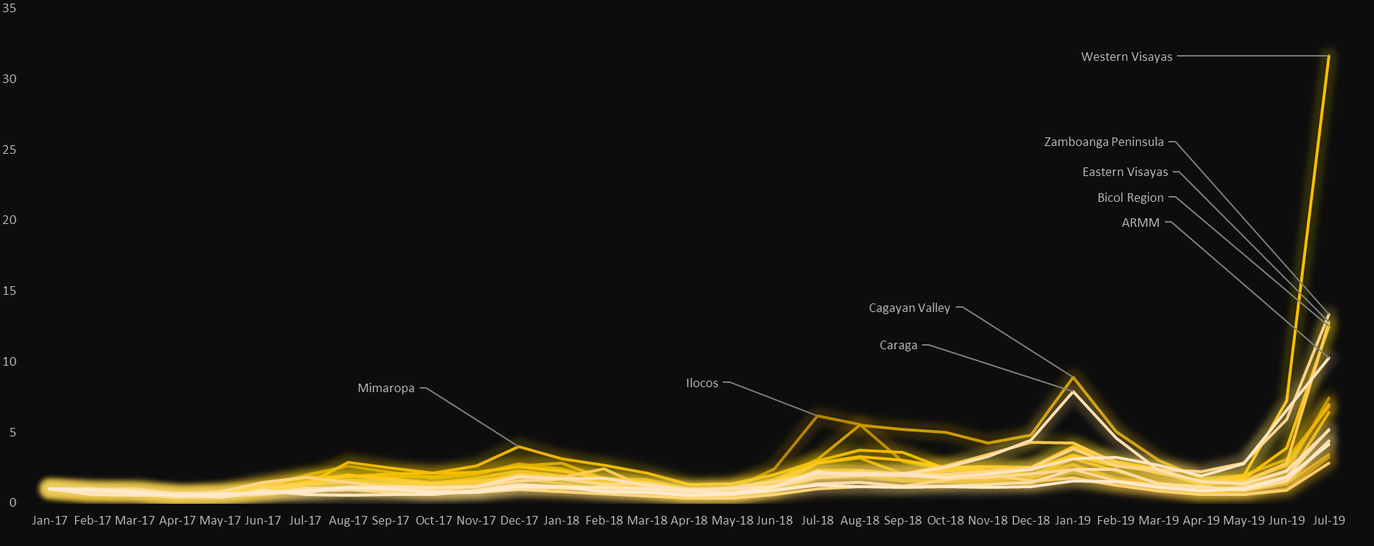
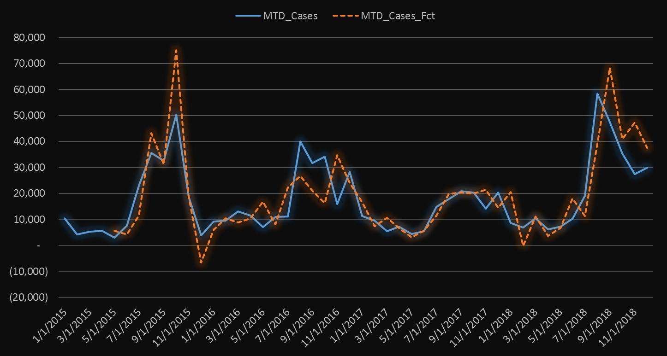
Digital Syndromic Surveillance
Google Dengue-related Searches
Dengue cases and Nowcast

Slide 15
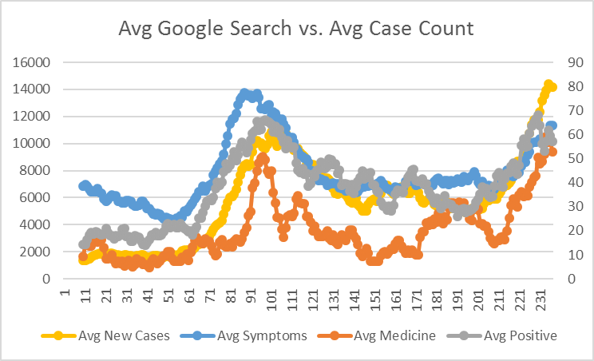
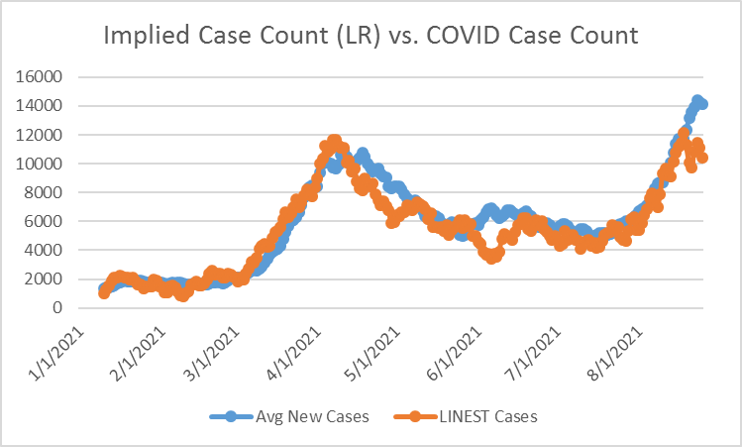
Digital Syndromic Surveillance
Correlation of COVID-related Google Searches and COVID cases
Implied COVID cases nowcasted by Google Trends

Slide 16
Expanded Disease Use-cases
Vector Borne | Airborne | Bacterial, Food and Water-borne | Zoonotic
Dengue Malaria Chikunggunya Zika | COVID-19 TB Respiratory | Cholera Tetanus | Rabies Leptospirosis

Slide 17
Consultants
Emily Vizmonte
Mark Pascual
Xavier Puspus
Project Manager and
Tech Lead
Cloud and
Data Engineer
Machine Learning
API Management
Researchers/Interns
Data gathering and research

Slide 18
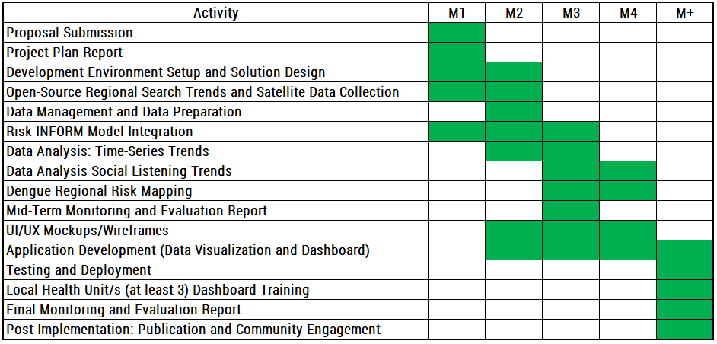
Execution Plan

Slide 19
Outputs
Type | Output
Product | Project AEDES - Social Trends, Dengue Trends, Dengue Risk Indices and Mapping (1)
Publications | Research Paper (2)
Publications | Policy Paper (1)
People Services | Training for Researchers and Health Units (3)
Partnerships | LGUs (2)

Slide 20
Statement of Work
Dates | Milestone
Jan 3rd Week | Inception Report 1) Workplan 2) Report on the proposed environment set up 3) Review of open-source regional search trends 4) Data management and data preparation 5) Assessment of Project AeDES
Mar 4th Week | Midterm Report 1)Reports on the following: - Risk Inform model integration - Data analysis time series/social listening risk mapping - Dengue Risk mapping 2) UI/UX mockups 3) Update on application development
April 2nd Week (no cost extension until May) | Final Report 1) Complete application development based on approved project plan 2) Testing results 3) Deployment report 4) Training materials 5) Pilot report 6) Training report

Slide 21
AEDES Command Center
AEDES Engine – Precomputed
Query
Data Gathering
Database
Region
Facebook
Google
Twitter
Public
Client Engineers
Training / Support
Report
Complete
Queue
Produce Reports
Analytical Engines
AI / ML
Dashboard
Reports Dashboard
Network Maps
Social Listening

Slide 22
Workflow
Infrastructure Setup
ML Pipeline Dev
Local
Big Data Processing
ML Analysis
Cloud
Time-Series Trends
ML Deployment
Training and Retraining Models
Local Instance
Data Mapping
ML
Social Listening Trends
Github
Testing Models
Cloud Instance
Data Collection
Regional Risk Mapping
Hazards
Database Design
Model Deployment
Vulnerabilities
Data Warehouse
API Development
Product Development
Coping Capacity
Get dengue trends per region
Portal Development
Product Design
EpiBureau
Dengue Panic
Get risk level per region
Integrate ML and API
Social Listening
Get Hazards, Vul, Coping
Testing
Data Collection Automation
Risk Mapping
Token Generation
User Changes
Action and recommendations
Deployment
Performance Monitoring
Publication
Admin Module
Training
Notes:
Data Analysis: Time-Series Trends Data Analysis Social Listening Trends Dengue Regional Risk Mapping

Slide 23
Process
Remote Sensing
Social Listening
Mobility
Socio Economic
Variable
Automation
Data Sources
Data Sourcing
Data Transformation
Query / API
Pending Ticket
Raw Data
User
Analyst
Data Engineering
Transformed Data
View
Outputs
API Management
Analytic Query
Data Analysis
Client View
Analysis / ML
Data Warehouse
Service Provider View

Slide 24
Sustainability Plan
Kick start LGU Engagement
Lean Canvas - Cost and Fee Structure, establish “Business” Model
Establish investment runway before self-funding status

Slide 25
LGU Engagement
LGU Coverage | Current Status
San Fernando, Pampanga | Inactive MOU – via PSPHP, need to revisit
CALABARZON | Existing engagement with DOST R4
Tacloban, Eastern Visayas | No relationship
Iloilo, Western Visayas | Initial linkage via DAP, Project SPARTA
Cotabato, BARMM | Initial linkage via TAF, UNDP, UNICEF Country Office

Slide 26
Development Roadmap (Internal)
NASA Space Apps
Public Launch
International Launch
EO4SDG
Digital Public Good
Beta Customer Base
(1-5 Agencies/LGUs)
Alpha Production Ready
Internally Supported Adhoc
2019-2021
This Proposal
2021-2022
Seed Investor
2022-2023
Self-Funded
2024+
Accelerator / VC

Slide 27
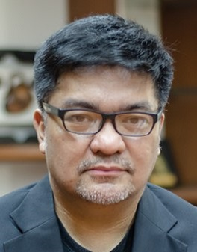

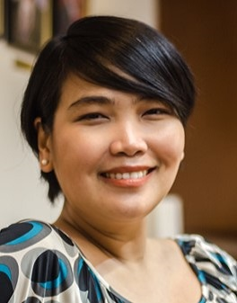

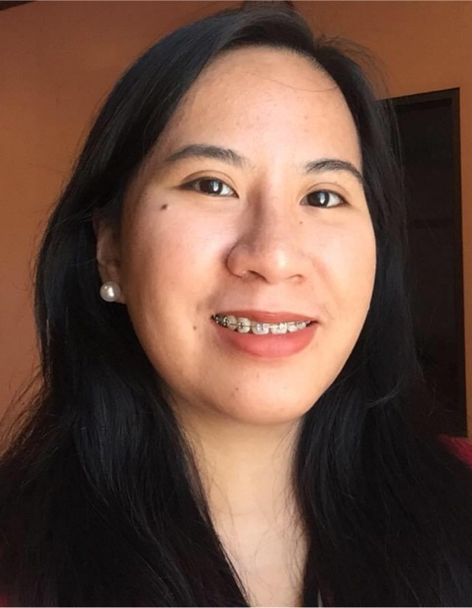
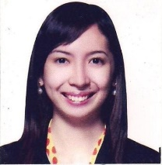

Team Members
Dominic Ligot
Mark Toledo
Claire Tayco
Cricket Soong
Rache Melendres
Emily Jo Vizmonte
Mark Pascual
Computational Social Science, Clinical Epidemiology
Big Data Engineering
Statistical Models, Machine Learning
Community Engagement, Emerging Technologies
Geospatial Modeling, Agricultural Bio-technology
Risk Modeling
Web Engineering

Slide 28

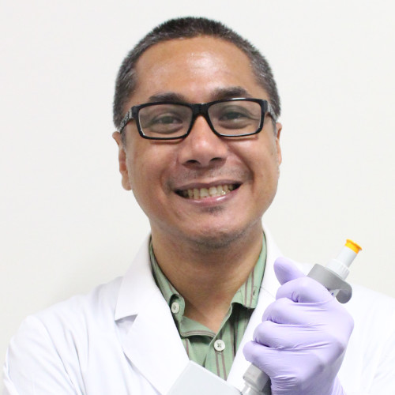

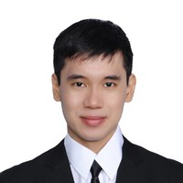
Board of Advisers
Mike Promentilla
Thaddeus Carvajal
Wilson Chua
Mike Domagas
Chemical Engineering, Environmental Risk Mapping
Dengue and Mosquito Research
Big Data Analysis
NASA, ESA, Satellite Research
GLOBE Mosquito Project
Mosquito RealTime Census Project

Slide 29
Variable Components
Google
Brand Mentions
Social Searcher
Crowdtangle
GDELT
Fixed Component
Functions
Data Sources
Data Sourcing System
Automation
Client Query
Pending Ticket
Input Raw Data
Data Engineering
Client
Ticketing System
Analyst
Data Prep System
Output View
Completed Outputs
Curated Data
Internal Query
Data Warehouse
Data Analysis System
Data Analysis

Slide 30
Thank You
CirroLytix Research Services
October 2021

